Slide 1
Group 20
Phase 5 Presentation

Slide 2
GeoSpatial Operations
Geometry Union
Convex Hull
Farthest Pair
Closest Pair
Spatial Range Query
Spatial Join Query
Spatial Aggregation

Slide 3
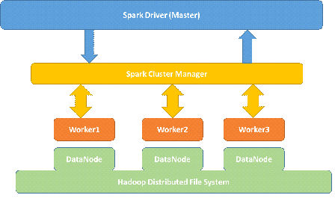
System Architecture
Spark Cluster Manager
Standalone Cluster with one Master node and 3 worker nodes
HDFS
Spark reads from and writes to HDFS

Slide 4
Pre Requisites
Operating System: Ubuntu 14.04.1 LTS 32-bit
OpenJDK 1.7.0
Hadoop 2.6.0
Spark 1.2.0
SSH
Maven2
Eclipse Luna
Ganglia

Slide 5
Geometry Union
Maps data points into different partitions
Performs a local “Cascaded Polygon Union”
Collects the unions into an RDD using re-partition
Performs another “Cascaded Polygon Union” to get the resultant union polygon
Sorts the output points
NOTE: The algorithm, Polygon Union, is based from a research paper by Avraham Margalit and Gary D. Knott. The algorithm is based on classification of edge points, and merging intersection points for the purpose of getting a union of 2 polygons. Cascaded polygon union works with recursively using this algorithm on multiple polygons.

Slide 6
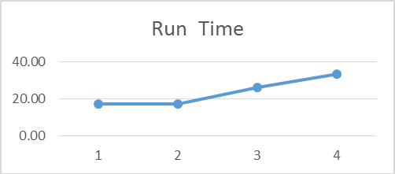
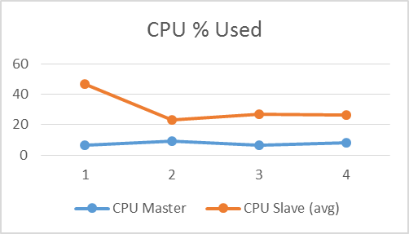
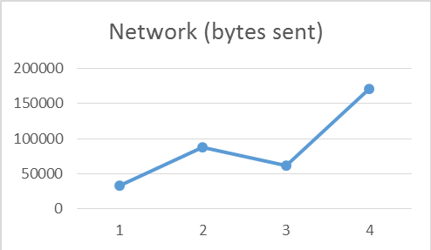
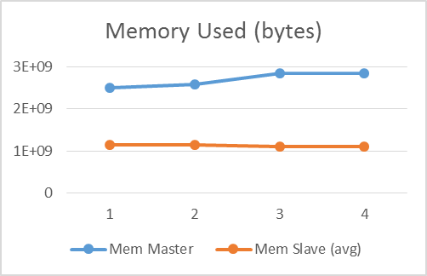
Geometry Union - Runtime Analysis

Slide 7
Convex Hull
Calculates upper hull, then lower hull, then combines together for convex hull
Sort the points in X, Y order (ascending for upper, descending for lower)
First point is always on the hull
Compare slope of first to second point with slope from first to third point
Handle the special case of vertical sets of points
If first to second slope is greater, then second is added to the upper slope
If not, then discard second point, move third point to second and use next point as third point
Repeat until all points evaluated.
Iterate over the last two steps until no points are removed
Combine the upper and lower hulls. Remove redundant points
first and last at least

Slide 8
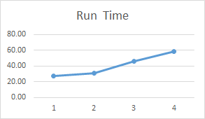
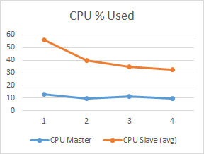
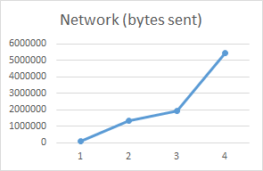
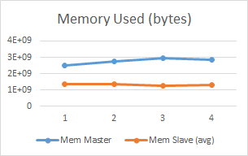
Convex Hull - Runtime Analysis

Slide 9
Farthest Pair
Farthest pair should lie on convex hull
Call convex hull operation and get all the point on convex hull
For each pair on convex hull compute euclidean distance
Return the pair of points that are far apart

Slide 10
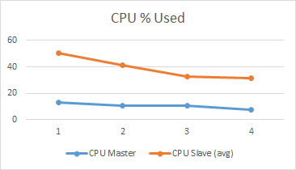
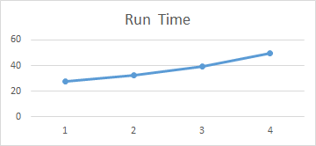
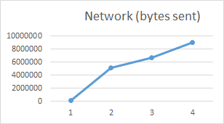
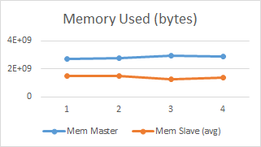
Farthest pair - Runtime Analysis

Slide 11
Closest Pair
Uses a Divide-and-Conquer technique
Each dataset is divided and we recursively find the closest pair
Sort the dataset w.r.t x and y coordinates, and create two different datasets.
Run the recursive algorithm on these two datasets.
Recursion base case stops the recursive calls when number of points in the list are less than or equal to 3.
For recursive call, find the median and split the datasets

Slide 12
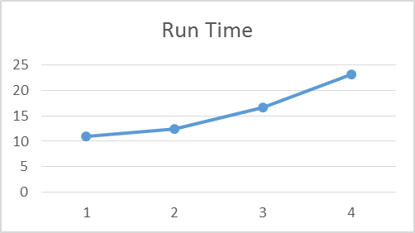
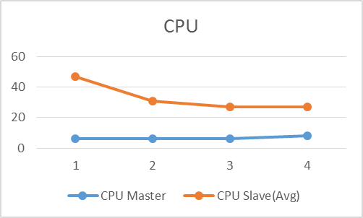
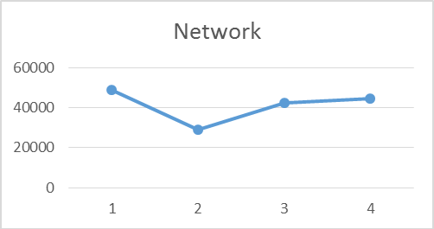
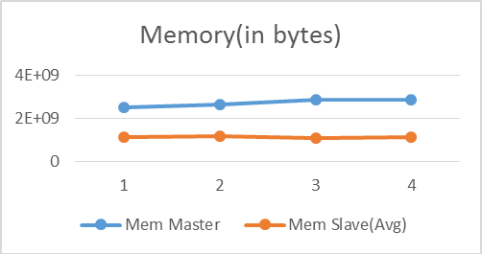
Closest pair - Runtime Analysis

Slide 13
Spatial Range Query
Spatial Range Queries are used to inquire about certain spatial objects which lie inside a certain query window.
Rectangle (Left Bottom, Top Right)
Each of the GeoPoints are checked against a given query rectangle window.
The result contains all the GeoPoints contained inside the query window.

Slide 14
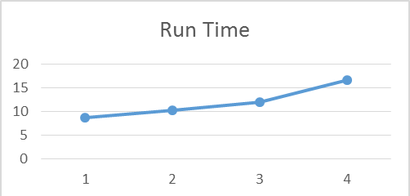
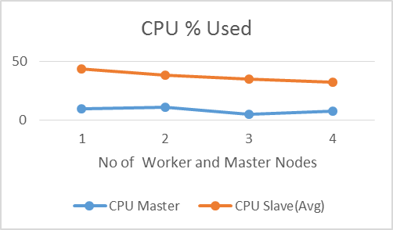
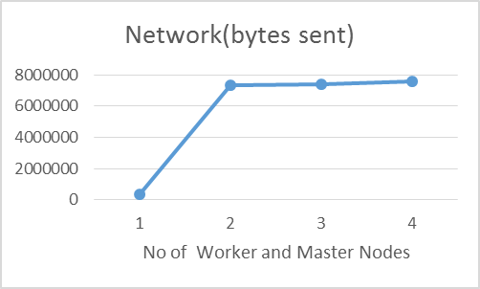
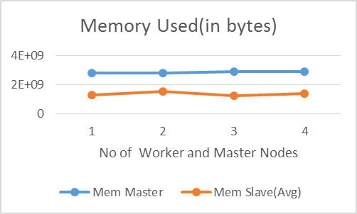
Spatial Range Query - Runtime Analysis

Slide 15
Spatial Join Query
Spatial Join Queries are used to inquire about certain spatial objects which lie inside a certain query window.
Spatial Join deals with two types of input data
Rectangle (Left Bottom, Top Right)
Rectangles that contains Points
Each of the GeoPoints are checked against given query rectangle windows.
Result contains all the GeoPoints that lie inside or on the query rectangle windows
Rectangles that contains Rectangles
Each of the Rectangles are checked against given query rectangle windows.
Result contains all the Rectangles that lie inside or intersecting or on the query rectangle windows.

Slide 16
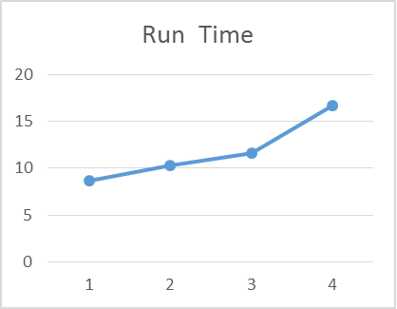
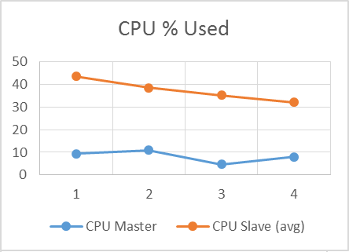
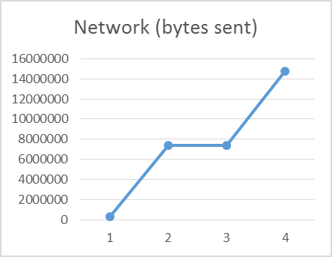
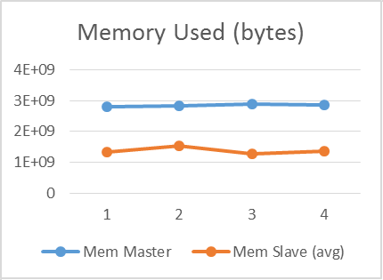
Spatial Join Query- Runtime Analysis

Slide 17
Spatial Aggregation
Spatial aggregation refers to count of points that lie each rectangle
Call spatial join operation
Foreach line split line by comma and emit rectangle id and count of array length -1
Aggregate the count of values based on rectangle id.
Foreach rectangle id emit rectangle id and count of points in it.

Slide 18
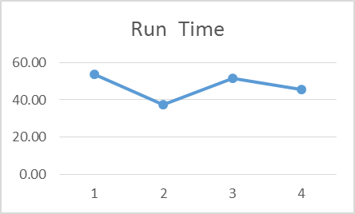
Spatial Aggregation - Runtime Analysis

Slide 19
Team Members
Anoop Sahoo
Bernard Ngabonziza
Jon Lammers
Madhu Meghana Talasila
Nagarjuna Myla
Vageesh Bhasin

Slide 20
Thank You !!!!!

